Slide 1

Identifying marketing investment efficiencies
Study name
LIFT ROI
Fecha

Slide 2

Agenda
Project status
Scope / Objectives
Timeline and next steps
Category overview
3. Brand focus
Media deep dive

Slide 3
1
Project status

Slide 4





Objective
Understand the impact of marketing efforts in sales and/or brand equity.
For that, we decompose sales volume and/or measured brand equity results, isolating the effects of each marketing effort to understand their individual effects.
Direct impact in
LiftROI Model
Sales
Equity
Input:
XX years of monthly/weekly data:
Brand sales, distribution and average price.
Media investment and media activity results (TV, OOH, Digital, etc.)
Other marketing efforts (owned media activity, innovations, promotions, etc.)
Macroeconomic variables

Slide 5
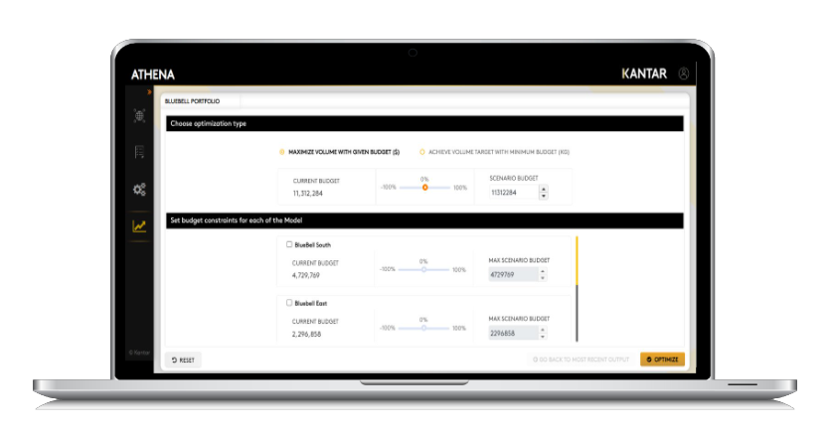
At the end, we’ll have the following results:
Illustrative
1. Sales decomposition / Equity decomposition
2. Incremental volume for each individual effort
1,280
X
1,080
Facebook
880
Search
680
Ventas / Equity
480
Banner
280
YouTube
80
Tiempo
3. ROI and saturation curves
4. Optimization
ROI | 2.8 | 3.4

Slide 6






Timeline
Average execution time since Kick Off ~ 17 weeks
Scope check |  | Data check | Insights check
1. Model design | 2. Data collection | 3. Data sign off | 4. Modelling | 5. Final report | 6. Simulations
Kick-off call | Data collection and validation | Data sign off for modelling | First presentation of model results | Final report delivery | Simulations
Scope Contact mapping | Data descriptives and variables transformations | Descriptives presentation to client Data sign off from client Data lockdown for modelling | Base presentation Contributions Preliminary checks | Final presentation Contributions ROI Saturation curves | Simulation scenarios for media planning
Week 0 | Week 1-3 | Week 4 | Week 5-11 | Week 17 | From week 17
%m-%d-%Y | %m-%d-%Y | %m-%d-%Y | %m-%d-%Y | %m-%d-%Y | %m-%d-%Y

Slide 7
Model technical spec (1/2)
Category: xxx
Brand: xxx
Period: xxx
Frequency: xxx
Analysis breaks: xxx
Coverage: xxx
Sales channel: xxx
Dependent variable: xxx

Slide 8
Overall sales volume contribution

Slide 9
Media sales volume contribution

Slide 10
Media sales volume contribution

Slide 11
Contribución de medios vs contribución total en volumen

Slide 12
Inversion en medios vs contribución en volumen

Slide 13
Media performance analysis

Slide 14
Media ROI – ROI
ROI 23' Camp
ROI 24' Camp

Slide 15
Campaign contribution and ROI
 | Volume contribution |  | Revenue contribution |  | ROI
 | 23' Campaign | 24' Campaign | 23' Campaign | 24' Campaign | 23' Campaign | 24' Campaign
Media Digital Display | 1,054.24 | 0.00 | 96,765,546.67 | 0.02 | 5.27 | 0.00
Media Digital YT+Meta | 2,147.61 | 1,714.01 | 198,765,016.17 | 165,881,365.09 | 3.97 | 1.21
Media OOH Retail | 746.11 | 456.23 | 69,650,944.54 | 43,980,687.14 | 3.54 | 1.42
Media OOH Screen | 1,227.36 | 0.00 | 113,636,955.37 | 96.84 | 2.49 | 0.00
Media Search Google | 383.08 | 200.02 | 35,050,143.16 | 19,392,844.41 | 5.00 | 2.82

Slide 16
Due to's - FY'24
Variable | Explanation
Price | Bla bla
Media | ….
External | ….
Distribution | ….
Discounts | ….
Competition | …
Base | …

Slide 17
Full media comparison

Slide 18
Saturation curve – Online Display

Slide 19
Saturation curve – Out of Home Retail

Slide 20
Saturation curve – FB_YT

Slide 21
Saturation curve – Out of Home Screen

Slide 22
Saturation curve – Google Paid

Slide 23
Saturation curves thresholds
 | Breakthrough | Maximum ROI | Start of Saturation | Full Saturation | Current Average
Media Digital YT+Meta | 3,354,606 | 22,044,555 | 33,546,063 | 45,287,184 | 38,520,675
Media Search Google | 1,687 | 4,982 | 6,026 | 10,044 | 16,942
Media Digital Display | 42,160 | 170,000 | 190,400 | 257,040 | 1,177,647
Media OOH Retail | 5 | 10 | 12 | 15 | 36
Media OOH Screen | nan | 43 | nan | nan | 153

Slide 24
Media optimization - Media OOH Retail
ROI
Effectiveness
CPA
 | Breakthrough | Maximum ROI | Start of Saturation | Full Saturation
Media OOH Retail | 5.31 | 9.83 | 11.60 | 14.75

